Slide 1
Mountain View Streaming Platform
Movie Recommender System Analysis
Leveraging matrix factorization and content analysis to reduce churn through personalized content surfacing.

Slide 2
BUSINESS OVERVIEW
The problem
User Churn
Mountain View Platform faces a critical challenge: users are leaving the platform when
recommended content fails to match their unique viewing
preferences.
The goal
Personalization
Reduce churn by personalizing
the home screen specifically
for returning users who have
provided at least 10 historical
ratings.
The strategy
Top-5 Delivery
Surface the Top-5
personalized movies.
For new users, an onboarding survey of
5-10 popular titles mitigates the cold-start problem.

Slide 3
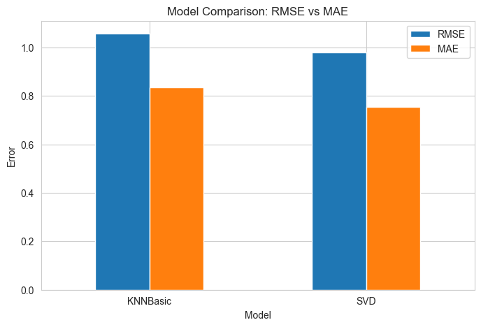
BUSINESS OBJECTIVES AND SUCCESS CRITERIA
SVD outperforms KNN Basics
.
Success Metrics
SVD outperforms KNNBasic
Hyperparameter tuning improves SVD
Generate Top-5 personalized recommendations
Address cold-start users
Business objectives
.Increase user retention
Increase User engagement
Balance popular content with personalized recommendations
4.Support new and returning Users

Slide 4
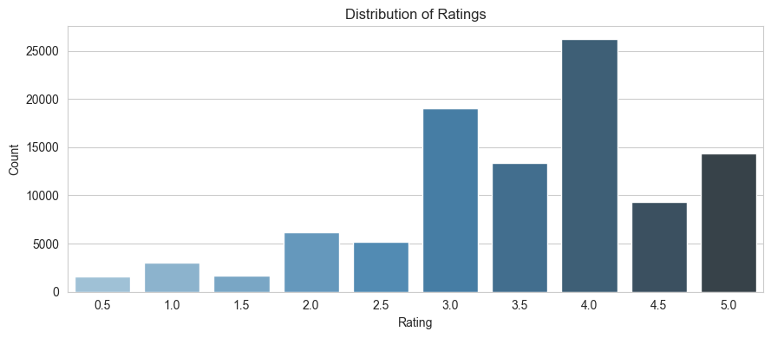
DATA INSIGHTS
32M
TOTAL RATINGS.
Drama and Romance, Comedy and Romance are the most frequent genre pairings.
Ratings range from 0.5 to 5.0, with a
mean of 3.5. Most users tend to rate
positively.

Slide 5
MODEL PERFORMANCE
0.67
RECALL@ 5
The system successfully identifies a high proportion of movies that users would actually like
0.15%
PRECISION@5
Lower precision reflects the challenge of "correct" niche predictions being buried by popular content.
Popularity Bias & List Quality
The Bias: Collaborative filtering tends to favor widely-liked movies, often missing specific individual tastes in the Top-5 list.
Recommendation Gap: While recall is high, the low precision indicates that the "hits" are often not in the top-most positions.
Strategic Need: Future iterations require re-ranking strategies to penalize over-exposed popular content and boost diversity

Slide 6
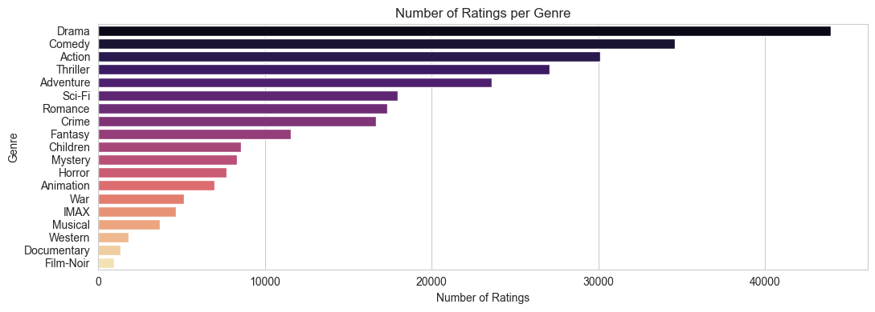
GENRE DOMINANCE AND CONTENT DIVERSITY
Genre Concentration: Drama and Comedy heavily weight the dataset.
Diversity Gap: Standard collaborative filtering may overlook niche genres like Documentary or Film-Noir without active intervention.
Strategic Balancing: Using genre-based cosine similarity helps maintain diversity, especially during the critical cold-start phase.

Slide 7
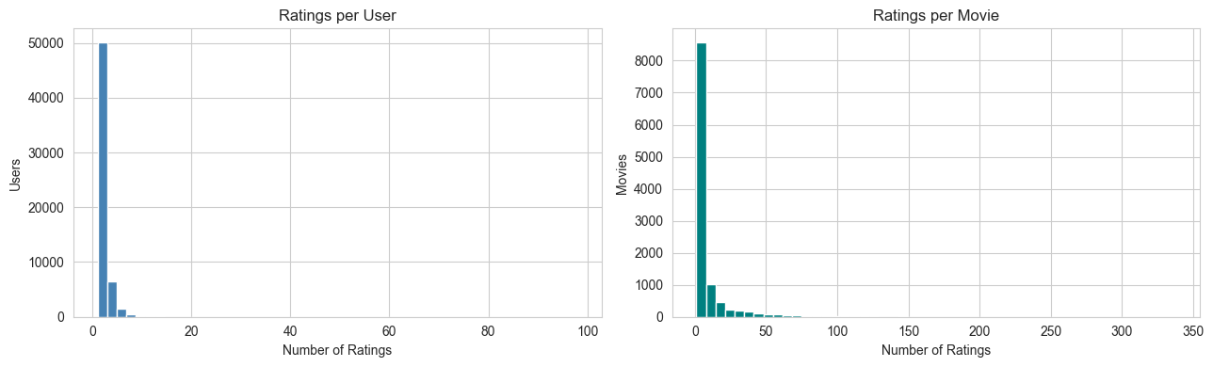
The Long-Tail Problem
Right-Skewed Data: A small number of "blockbuster" movies receive the vast majority of ratings, dominating the model.
Power User Bias: A minority of users contribute most of the data, potentially skewing recommendations toward their specific tastes.
The Long Tail: Niche movies lack sufficient interaction data, making them difficult for collaborative filtering to surface.

Slide 8
Solving the Cold-Start Dilemma
Returning Users
SVD Model: Active when user has ≥ 10 ratings
Personalization: Leverages latent features from historical interactions.
Output: Highly specific Top-5 movie predictions
New Users (1-9 Ratings)
Content-Based: TF-IDF vectorization on movie genres
Similarity: Recommends items similar to the few movies already liked
Bridge: Maintains quality until enough data is gathered for SVD.
Zero-Data Users
Popularity Fallback: Surfaces highest-rated movies with > 50 ratings
Conversion: Goal is to prompt the first 10 ratings quickly.

Slide 9
Conclusion: Path to a Scalable Recommender
SVD Superiority: Matrix factorization consistently outperforms KNN in handling sparse movie rating data.
Full Dataset Training: Moving from 100k samples to the full 32M ratings is expected to close the RMSE/MAE gap
100% Coverage: The combination of SVD and Content-Based models ensures every user receives recommendations.
Richer Metadata: Incorporating cast, directors, and plot keywords to improve cold-start accuracy.
Diversity Re-ranking: Implementing penalties for over-exposed popular content to boost niche discovery.

Slide 10
THANK YOU Q&A

